Slide 1
California State University, East Bay College of Business and Economics
MGMT 6165 Prescriptive Analytics
Introduction to Modeling and Spreadsheet Modeling
Lecture Materials
Dr. Z. Radovilsky
Notes:
1
1

Slide 2
Learning Objectives
Explain descriptive and prescriptive (optimization) analytical approaches
Define optimization models and modeling
Explain the seven-step modeling process
Develop and solve business applications using spreadsheet modeling with Excel
Notes:
2
2

Slide 3
Why Data Analytics and Decision Modeling?
We are living in the age of information technology, which enables companies, among other things, to:
Collect huge amounts of data and make this collection easy
Give many more people the power and responsibility to analyze data and make decisions on the basis of quantitative analysis
Big data analytics
Virtually everyone now has a desktop or laptop computer in their disposal
Many have been trained in easy-to-use software, specifically spreadsheet and database software
By using data analytics and quantitative models, companies can uncover the important information in the data and then act on this information
Descriptive, Predictive, and Prescriptive (Optimization) Analytics
Companies are able to gain advantages over their competitors

Slide 4
Quantitative Model
A quantitative model is a quantitative (mathematical) representation, or idealization, of a real problem
It is a key to virtually every management science application
It can be phrased in terms of mathematical expressions (equations and inequalities) or a series of interrelated cells in a spreadsheet
The purpose of a quantitative model is to represent the essence of a problem in a concise form, providing several advantages
Enables managers to understand the problem better
Helps to define the scope of the problem, the possible solutions, and the data requirements
Allows analysts to employ a variety of the mathematical solutions
The modeling process, if done correctly, often helps to “sell” the solutions to the people who must work with the system

Slide 5
Model Types
Descriptive models: models that simply describe a business situation
Predictive models: models that predict forecast the future value or future business direction
Prescriptive (optimization) models: models that suggest a desirable course of action, usually an optimal (best) course of action
Example
Waiting line: Convenience store with a single cash register
The manager suspects that excessive waiting times in lines to the register hurt the business
The manager or invited data analyst builds a quantitative model, i.e., descriptive model, to help understand the problem, and suggest improvements to the current situation
The data analyst can convert this descriptive model into an optimization model to identify the optimal (best) solution

Slide 6
Investment Portfolio Selection
First Investment Co. is located in San Francisco. First Investment has obtained $120 million by converting industrial bonds to cash and is now looking for other investment opportunities for this money. Considering the company's current investments, the firm's senior financial analyst recommends that all new investments should be made in the wireless technology companies (Wireless System and Mobile First), service organizations (Dell Comp Service and Huber Tech Service), or in government bonds. Specifically, the analyst has identified five investment opportunities and projected their annual rates of return:
_____________________________________
Projected Rate
Investment of Return (%)
_____________________________________
Wireless System 6.3
Mobile First 10.3
Dell Comp Service 6.9
Huber Tech Service 7.5
Government Bonds 4.5
_____________________________________
Management of First Investment Co. has imposed the following investment guidelines:
Neither industry (wireless technology or service) should receive more than $60 million of the total investment.
Government bonds should be at least 25% of the wireless industry and service investments.
The investment in Mobile First, a high-return but high-risk investment, cannot be more than 60% of the total wireless industry investment.
What portfolio recommendations (investments and amounts) should be made for the available $120 million?

Slide 7
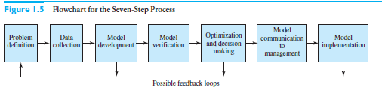
The Seven-Step Modeling Process

Slide 8
The Seven-Step Modeling Process
Step 1: Problem Definition
The analyst first defines the organization’s problem
Defining the problem includes specifying the organization’s objectives and the parts of the organization that must be studied before the problem can be solved
Step 2: Data Collection
After defining the problem, the analyst collects data to estimate the value of parameters that affect the organization’s problem

Slide 9
The Seven-Step Modeling Process
Step 3: Model Development
In the third step, the analyst develops a model of the problem
Some of these are deterministic optimization models, where all of the problem inputs are assumed to be known and the goal is to determine values of decision variables that maximize or minimize an objective
Others are simulation models, where some of the inputs are modeled with probability distributions.
Occasionally, the models are so complex mathematically that no simple formulas can be used to relate inputs to outputs

Slide 10
The Seven-Step Modeling Process
Step 4: Model Verification
The analyst now tries to determine whether the model developed in the previous step is an accurate representation of reality
The model must pass “plausibility checks.” In this case, various input values and decision variable values are entered into the model to see whether the resulting outputs are plausible
Step 5: Optimization and Decision Making
Given a model and a set of possible decisions, the analyst must now choose the decision or strategy that best meets the organization’s objectives
Many optimization models exist, and they will be discussed throughout the book

Slide 11
The Seven-Step Modeling Process
Step 6: Model Communication to Management
The analyst presents the model and the recommendations from the previous steps to the organization
Step 7: Model Implementation
If the organization has accepted the validity and usefulness of the study, the analyst then helps to implement its recommendations
The implemented system must be monitored constantly (and updated dynamically as the environment changes) to ensure that the model enables the organization to meet its objectives

Slide 12
The Model as a Beginning, Not an End
Emphasis is on developing and optimizing models, steps 3 and 5 of the seven-step modeling process
However, a completed model is really a starting point
After you have a working model of the problem, you can – and you should – use it as a tool for gaining insights
For most models, many what-if questions can be asked
If the model has been developed correctly, it should be capable of answering such what-if questions fairly easily.

Slide 13
Why Study Models and Modeling in Prescriptive Analytics?
The modeling approach an important way to think about problems in general, not just the specific problems we discuss This approach forces you to think logically
As you work through the many models in this course, your quantitative skills will be sharpened significantly
No matter what your spreadsheet abilities are when you enter this course, by the time you are finished, you will be a proficient spreadsheet user
Quantitative modeling helps you develop your intuition, and it also indicates where intuition alone sometimes fails

Slide 14
Why Use Excel?
Today, computers and software are critical parts of successful implementation of decision science including data analysis and decision modeling
Excel has all necessary capabilities to perform data analytics and spreadsheet modeling
Most quantitative models could be directly applied as spreadsheet tools
Excel has extensive possibilities in drawing charts and graphs, which are quite useful in quantitative data analytics
Excel can be effectively used to input, store, and manipulate data required for analysis. You can easily import data from other sources
Users are usually well exposed to Excel
You don't need to spend hours learning a new complicated software. You can do it on Excel in a matter of minutes
Excel tutorial online for beginner to advance level:
https://www.youtube.com/watch?v=8lXerL3DHRw

Slide 15
Basic Spreadsheet Modeling
Most quantitative models, including spreadsheet models, involve inputs, decision variables, and outputs
The inputs have given fixed values, at least for the purposes of the model
The decision variables are those a decision maker controls
The outputs are the ultimate values of interest; they are determined by the inputs and the decision variables
Spreadsheet modeling is the process of
Entering the inputs and decision variables into a spreadsheet
Relating them appropriately, by means of formulas
Obtaining the outputs

Slide 16
Projecting the Costs of Bookshelves at Woodworks
The Woodworks Company produces a variety of custom-designed wood furniture for its customers. One favorite item is a bookshelf, made from entire cherry and oak. The company knows that wood prices and labor costs are likely to increase in the future. The table below shows the number of board-feet and labor hours required for a bookshelf, the current costs per book-foot and labor hour, and the anticipated annual increases in these costs.
Build a spreadsheet model that enables the company to experiment with the growth rate in wood and labor costs so that a manager can see, both numerically and graphically, how the costs of the bookshelves vary in the next few years.
Objectives:
Build a model that allows Woodworks to see, numerically and graphically, how its costs of manufacturing bookshelves increase in the future
Allow the company to answer “what-if” questions with this model
Resource | Cherry, board-ft. | Oak, board-ft. | Labor, hrs.
Required per bookshelf | 30 | 30 | 16
Current unit cost | $5.50 | $4.30 | $18.50
Anticipated annual cost increase | 2.4% | 1.7% | 1.5%

Slide 17
Concepts and Best Practices of Spreadsheet Modeling
After the outputs are obtained, you can proceed in several directions
You might want to perform a sensitivity analysis to see how one or more outputs change as selected inputs or decision variables change
You might want to find the values of the decision variable(s) that minimize or maximize a particular output, possibly subject to certain constraints
You might also want to create charts that show graphically how certain parameters of the model are related

Slide 18
Concepts and Best Practices of Spreadsheet Modeling
You should construct your models with readability in mind, especially if the models are shared with others
Features that improve readability include:
A clear, logical layout to the overall model
Separation of different parts of a model, possibly across multiple worksheets
Clear headings for different sections of the model and for all inputs, decision variables, and outputs
Use of range names (optional in some models)

Slide 19
Concepts and Best Practices of Spreadsheet Modeling
Readability features continued:
Use of boldface, italics, larger font size, coloring, indentation, and other formatting features
Use of cell comments
Use of text boxes for assumptions and explanations
The formulas and logic in any spreadsheet model must be correct
Much of the power of spreadsheets derives from their flexibility
Plan ahead before diving in, and if your plan doesn’t look good after you start filling in the spreadsheet, revise your plan

Slide 20
Decision Models – Outsourcing Example
Suppose that a manufacturer can produce a part for $125/unit with a fixed cost of $50,000. The alternative is to outsource production to a supplier at a unit cost of $175
The decision depends on the anticipated volume of demand
For higher volume it is better to manufacture in-house
For smaller volume, it will be more economical to outsource

Slide 21
Outsourcing Example: Model Development
Model components
F = fixed cost of in-house manufacturing
v = unit variable cost of in-house manufacturing
c = unit cost of outsourcing
D = demand volume
Total manufacturing cost:
TMC = F + v*D
Total outsourcing cost:
TOC = c*D
Break-even demand point
D = F/(c-v)

Slide 22
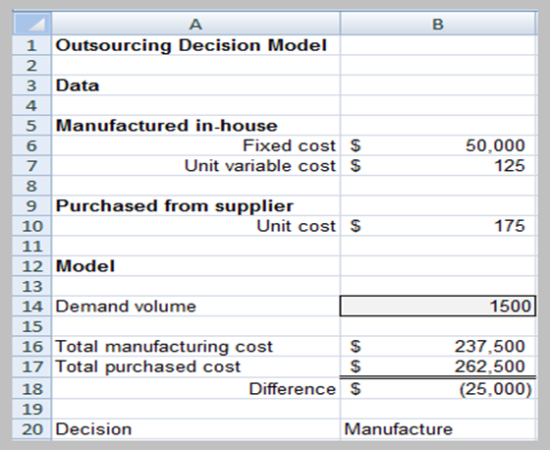
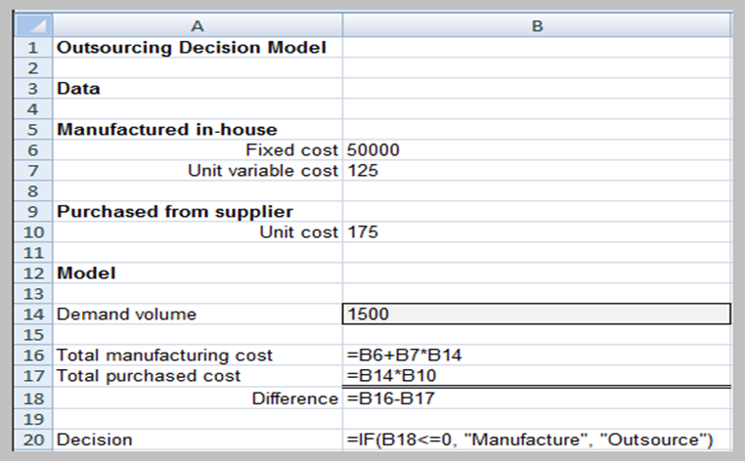
Outsourcing Model: Excel Demonstration

Slide 23
Model Analysis
What-If Analysis – evaluate how specific combinations of model inputs that reflect key model assumptions affect model outputs
Often called sensitivity analysis
Excel tools
Data tables
Scenario manager
Goal seek

Slide 24
Data Tables
Summarizes the impact of one or two inputs on a specified output
Excel tools
One-way data tables
Two-way data tables

Slide 25
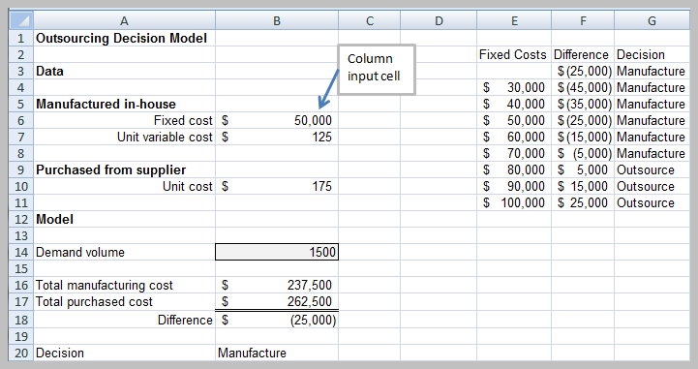
One-Way Data Table

Slide 26
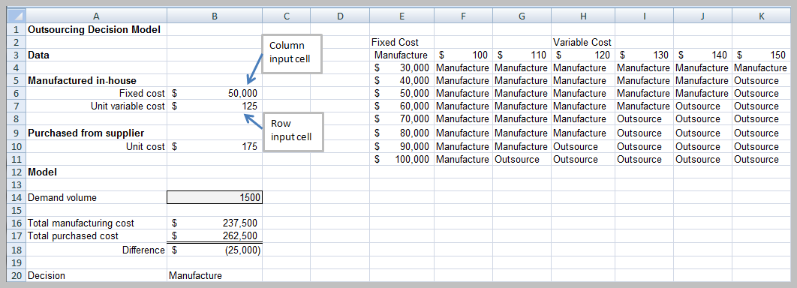
Two-Way Data Table

Slide 27
Scenario Manager
The Excel’s Scenario Manager tool allows to create scenarios – sets of values that are saved and can be substituted automatically on your worksheet
Scenarios are useful for conducting What-if analyses with more than two variables which data tables cannot handle
The Scenario Manager can handle up to 32 variables

Slide 28
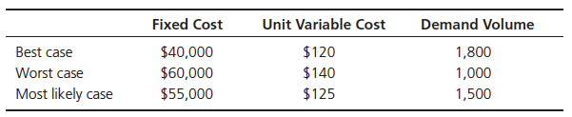
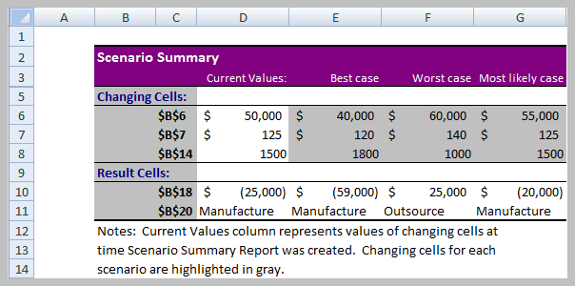
Scenario Manager Outsourcing Example

Slide 29
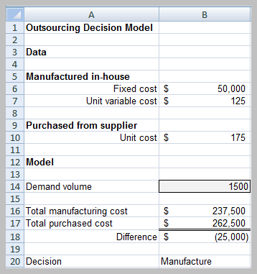
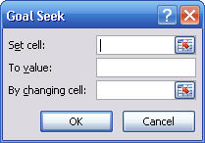
Goal Seek
Find the value of an input that produces a known result within a spreadsheet
Example: find the breakeven point in the outsourcing decision model
Set cell is B18;
To value = 0;
By changing cell is B14

Slide 30
Ordering with Quantity Discounts and Demand Uncertainty
Sam’s Bookstore, with many locations across the United States, places orders for all of the latest books and then distributes them to its individual bookstores. Sam’s needs a model to help it order the appropriate number of any title. For example, Sam’s plans to order a popular new hardback novel, which it will sell for $30. It can purchase any number of this book from the publisher, but due to quantity discounts, the unit cost for all books it orders depends on the number ordered. Specifically, if the number ordered is less than 1,000, the unit cost is $24. After each 1000, the unit cost drops: to $23 for at least 1,000 copies, to $22.25 for at least 2,000 copies; to $21.75 for at least for at least 3,000 copies; and to $21.30 (the lowest possible unit cost) for at least 4,000 copies. For example, if Sam orders 2,500 books, the total cost is $22.25*2500=$55,625. Sam is very uncertain about the demand for this book – it estimates it to be anywhere from 500 to 4,500. Also, as with most handback novels, this one will eventually come out in paperback. Therefore, if Sam’s has any hardbacks left when the paperback comes out, it will put them on sale for $10, at which price it believes all leftovers will be sold.
How many copies of this hardback novel should Sam’s order from the publisher?
Objectives:
Create a model to determine the company’s profit, given fixed value of demand and the order quantity
Model demand uncertainty
Choose the expected profit-maximizing quantity

